Slide 1
Baghdad Research Reactor Neutron Filter MCNP Flux Simulations
NE 155 Spring 2015: Final Project
----------------------------------------------------------------------------
Project Team: Joseph Labrum, Keeton Ross

Slide 2
Introduction
Baghdad Research Reactor: IRT-5000 (5 MW)
Experiments done in 1970’s by M. R. Ahmed and his team of Russian and Iraqi colleagues
Focus on inelastic neutron scattering of Fe and other metals
Crucial aspect is knowing the flux at the sample location
Flux approximated for behind a 10 cm Pb plug, not for actual neutron filter setup
Prof. Lee Bernstein very interested in a more accurate flux determination for his inelastic scattering calculations
Flux = Ae^{-B*E_n}
Proper flux calculation could open door to more accurate and confident nuclear data
Fun fact: “voluntarily decomissioned” by the United States Air Force in 1991 Operation Desert Storm

Slide 3
Problem Description
What exactly are we looking to achieve?!?!
A PDF of the total flux at the sample location
A more accurate B value for an exponential regression of log(Probability) vs. E_{n} at energies > 0.5 MeV
A better understanding of what certain materials and aspects of the collimators are doing
An estimate of how many neutrons would be incident upon our sample and detector array

Slide 4
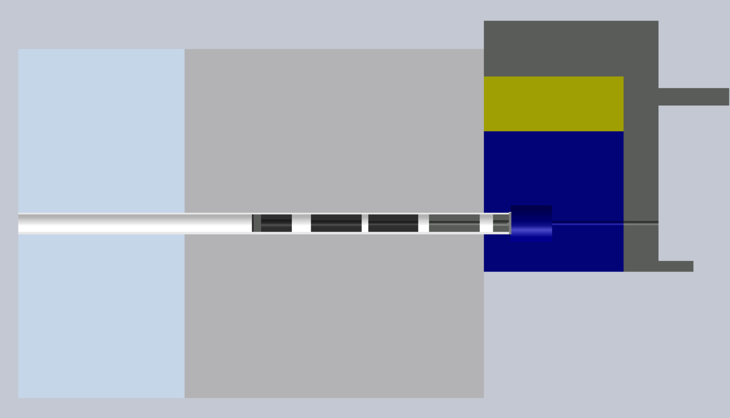
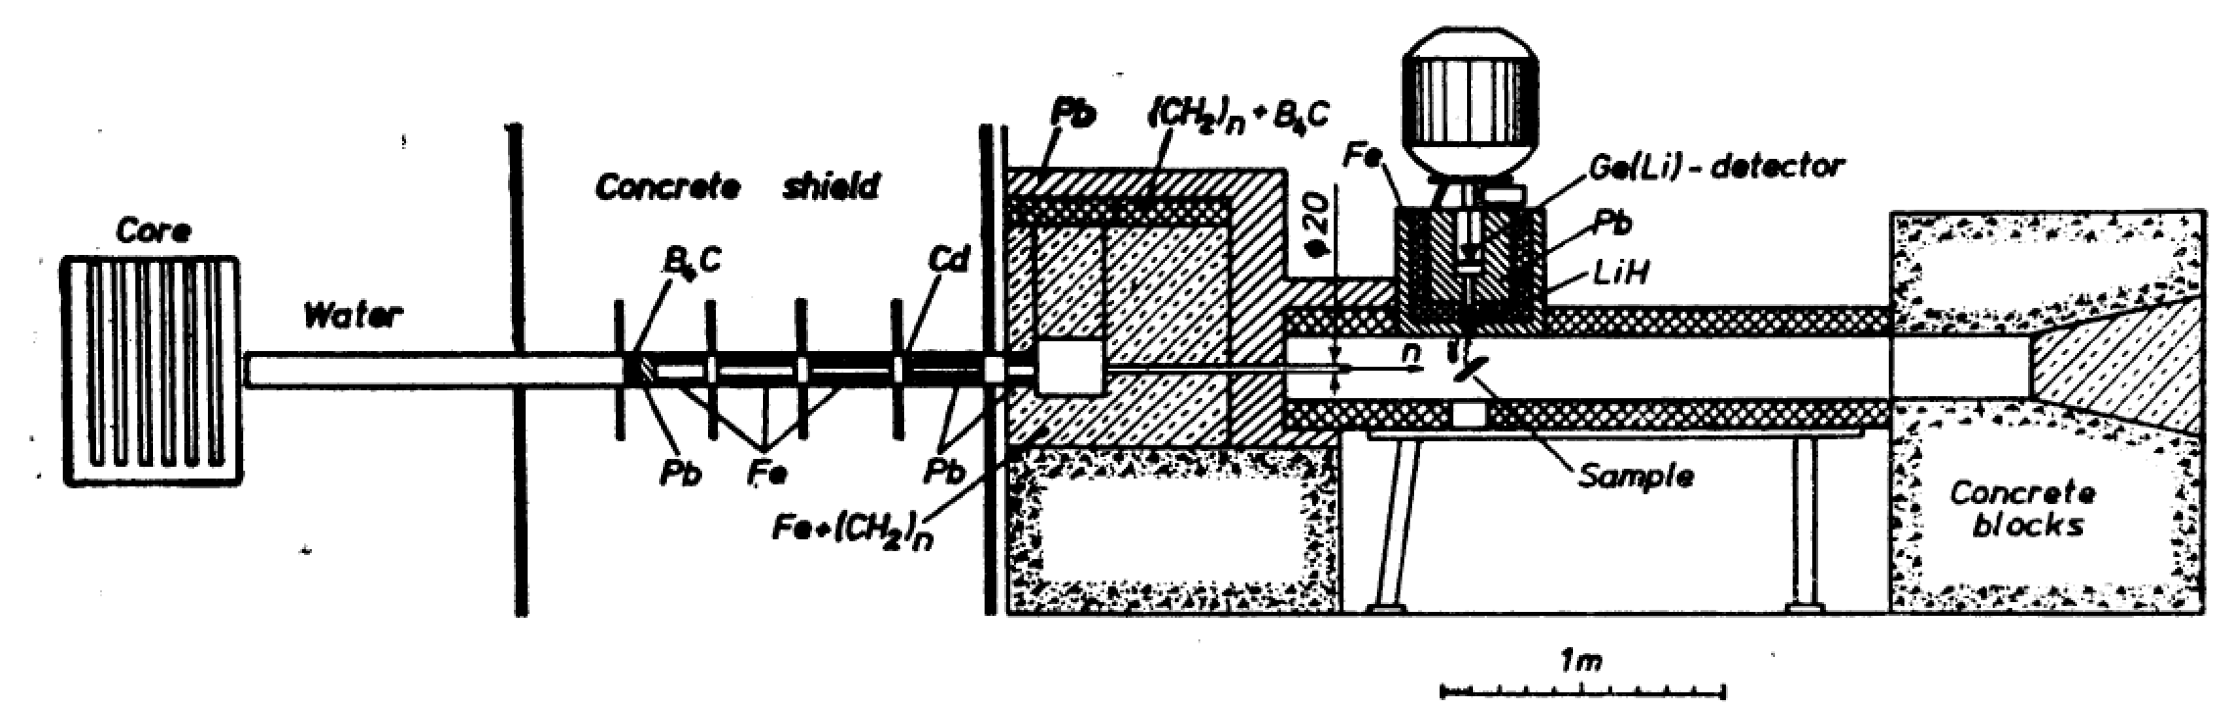
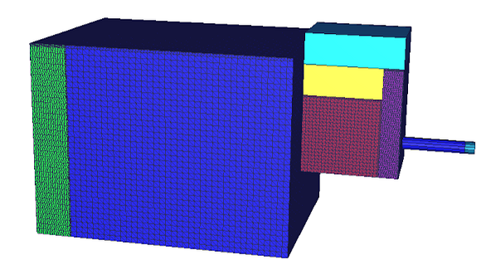
Description of Work
GEOMETRY MODELING

Slide 5
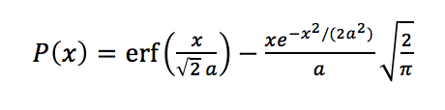
Description of Work (cont.)
ASSUMPTIONS
Picture drawn to scale
Pixels determined our scaling ability -> 1.25 cm = 1 pixel
Material assumptions
Mixed materials -> 50/50 mix
“Natural” materials
Point source with Maxwellian (a = 0.6 MeV)
Water and concrete were graveyards (speeds up calculations)
HYPOTHESIS/EXPECTATIONS
Used knowledge of solid angle, material properties, Maxwellian spectrum
Solid Angle ||
Knowledge of Cd, B, and Pb cross sections
Only looking for “fast” neutrons (i.e. E_{n} > 1.0 MeV)
dΩ=sinθdθdφ

Slide 6
Results
PDF of flux probability at sample with error bars
Log(Probability) vs. E_{n} with fitted y = Ae^{-Bx} regression
Fluxes at significant points along origin -> sample path
After B₄C, Pb, and Cd

Slide 7
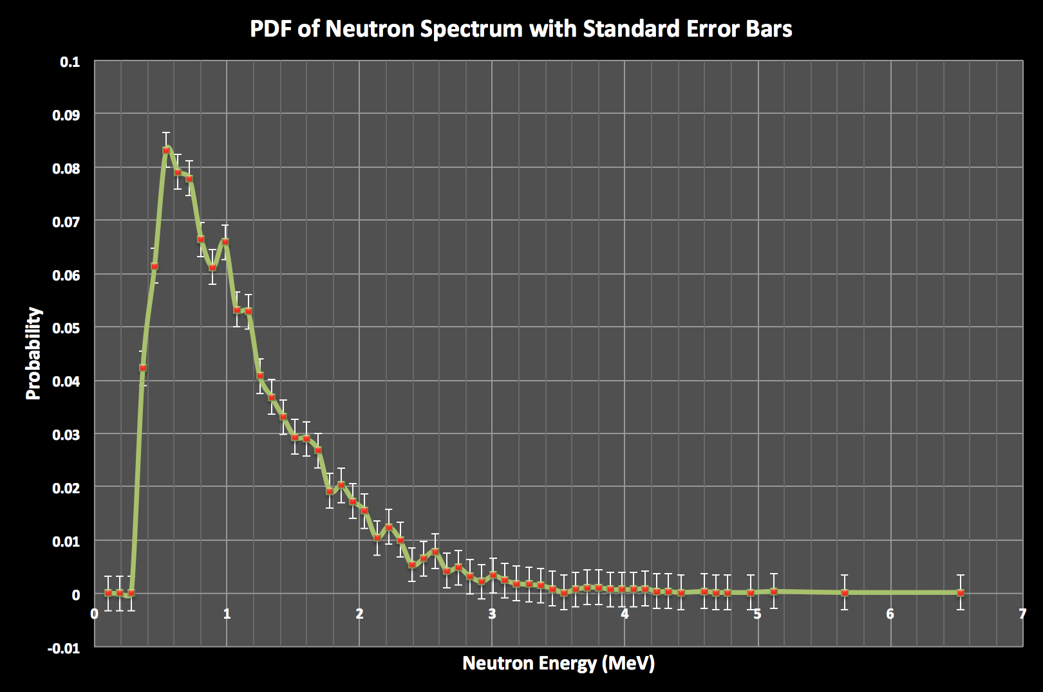

Slide 8
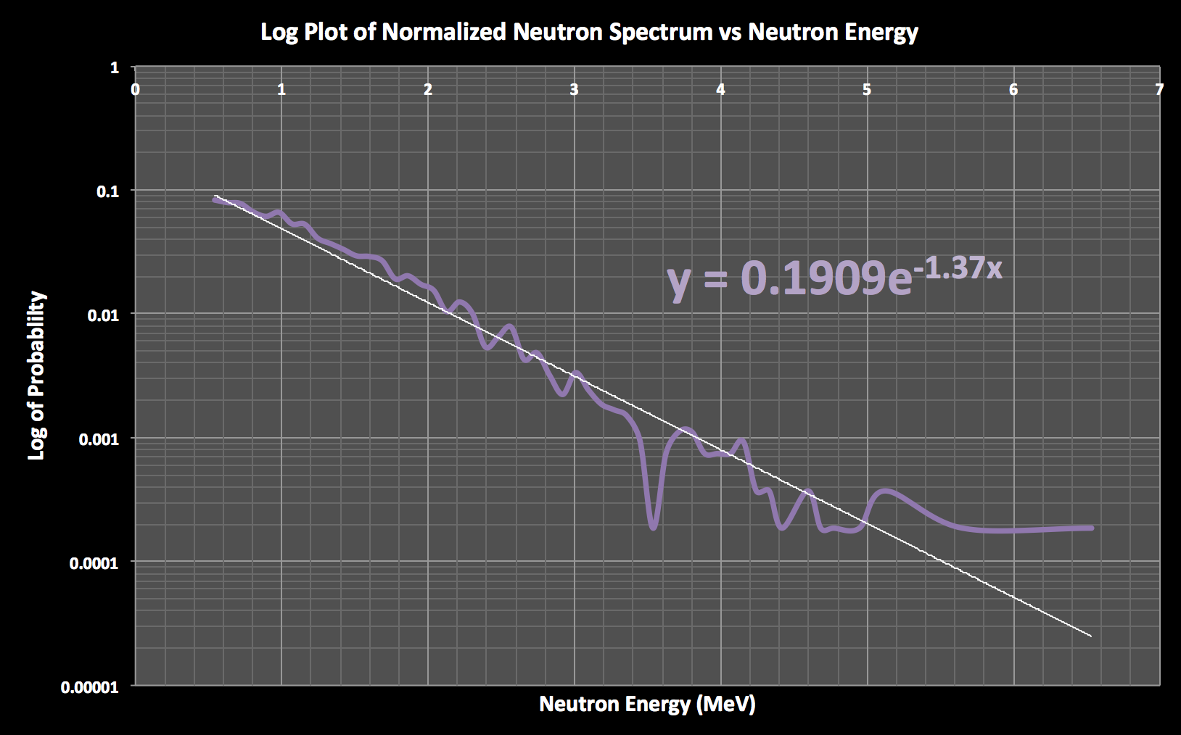

Slide 9
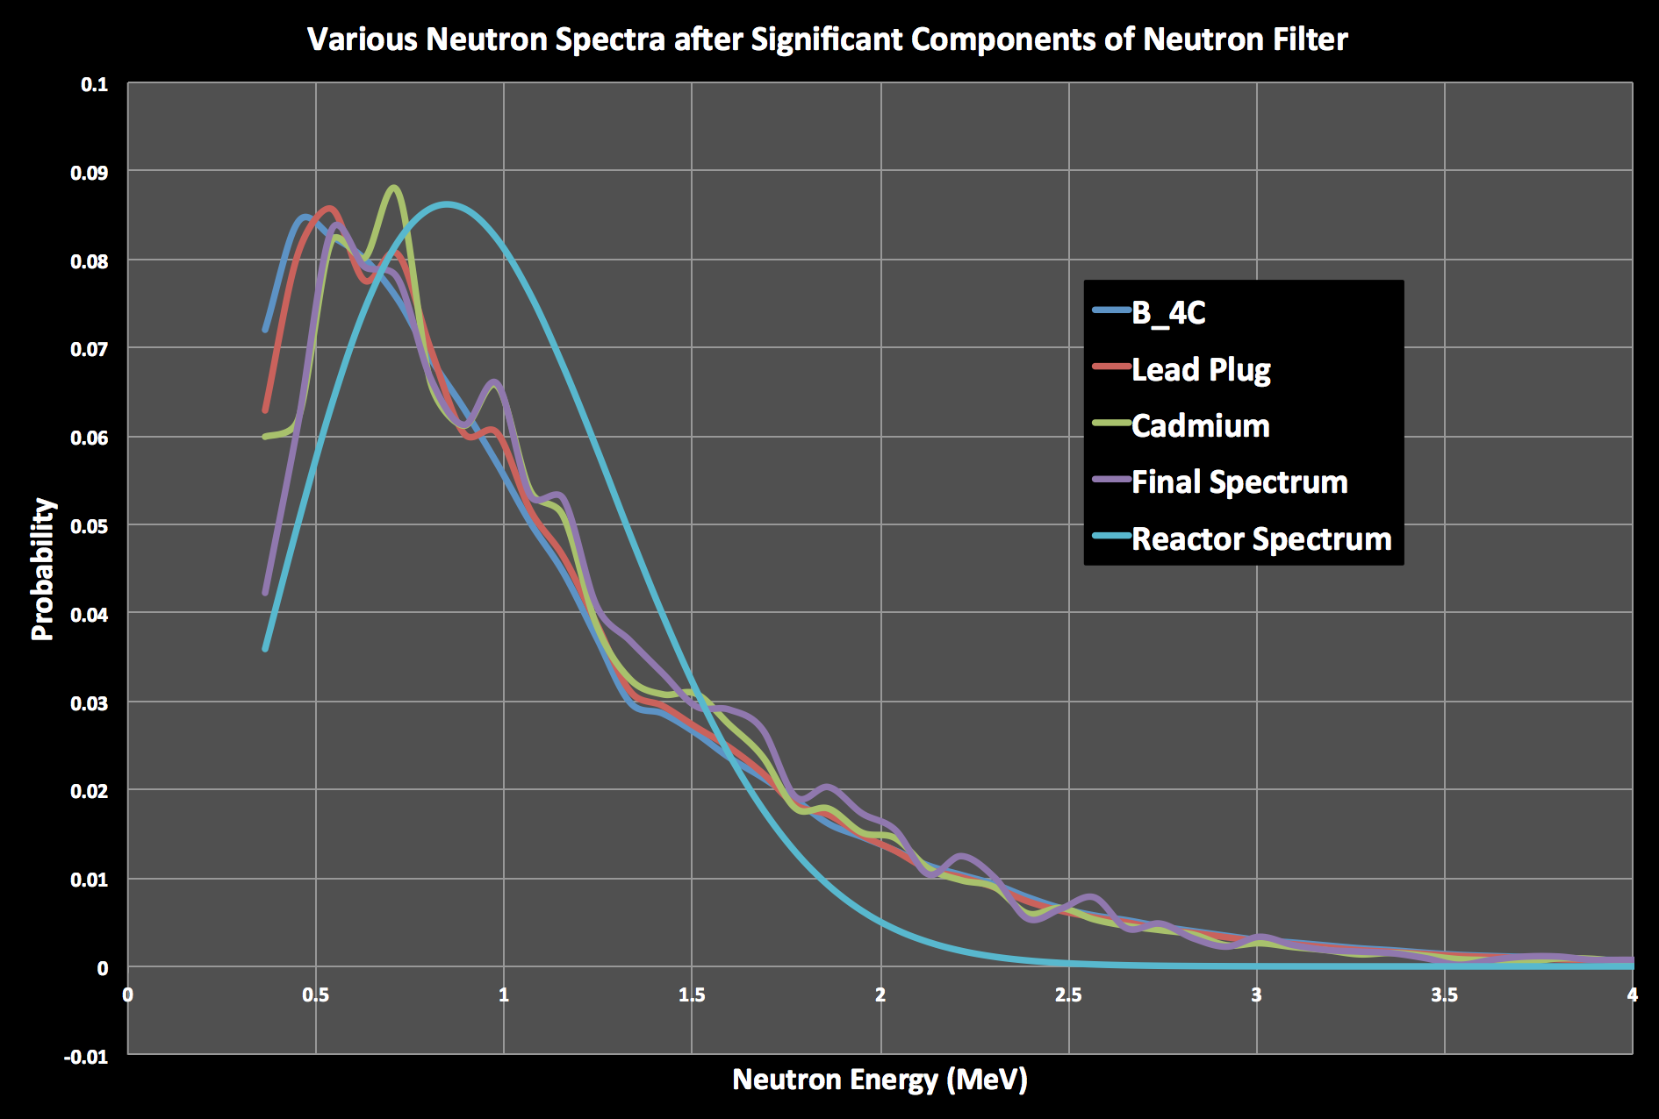

Slide 10
Conclusions
Standard deviation was fairly large at E_{n} > 2.5 MeV
Due to a relatively small number of particles ran
7.2 billion nps → ≈7 ms of running a reactor
“Probability = 0.1909e^{-1.37*E_n}”
B_{filter} = 1.37 in comparison to B_{initial} = 0.65-0.75
Material neutron attenuation affects
B₄C and Pb plugs had the greatest shift towards “fast”
Cd did not have a huge affect, but was also only 0.5 mm
Comparison of final to initial flux
Final shifted towards thermal but CDF is more favorable towards “fast” in final vs. initial
Comparison to hypothesis/expectation
Initially said fast flux >7.7e-5%, actual was 3.42e-5% which is surprisingly close!

Slide 11
References
[1] AHMED, M. R, SHAKARCHI, Kh., AL-NAJJAR, S., & AL-AMILI, M. A, Govor, L I., Demidov, A M. (1973). Investigation of Gamma-Ray Spectra from the Inelastic Scattering of Reactor Fast Neutrons. Nuclear Instruments and Methods. Nuclear Research Institute, Bagdad. I. V. Kurchatov Institute of Atomic Energy, Moscow.
[2] AHMED, M. R, SHAKARCHI, Kh., AL-NAJJAR, S., AL-AMILI, M. A, Al Assafi, N., Rammo, N. Govor, L I., Demidov, A M. (1978) ATLAS of Gamma-Ray Spectra from the Inelastic Scattering of Reactor Fast Neutrons (Part 1). Atomizdat. Nuclear Research Institute, Bagdad. I. V. Kurchatov Institute of Atomic Energy, Moscow.
[3] DMC. (2011, August 1). MCNP Tips: Materials. Retrieved May 11, 2015, from http://mcnptips.blogspot.com/2011/08/123.html
[4] Los Alamos National Laboratory. (2005) MCNP User Manual. RSICC Computer Code Collection. Oak Ridge Nation Laboratory. U.S. Department of Energy.
[5] Schwarz, A.L., Schwarz, R. A., & Carter, L. L. (2011) MCNP/MCNPX Visual Editor Computer Code Manual. Visual Editor Consultants.
[6] Shultis, J. K., & Faw, R. E., (204-2011). An MCNP Primer. Dept. of Mechanical and Nuclear Engineering Kansas State University.
[7] WolframAlpha. Maxwell Distribution. (2015). Retrieved May 12, 2015, from http://mathworld.wolfram.com/MaxwellDistribution.html

